Slide 1
PH1102E/GEK1067 Introduction to Philosophy
A/P Michael Pelczar

Slide 2
This module is a general introduction to philosophy. We’ll be talking about freedom, morality, the good life, God, consciousness, time, space, and deep mysteries surrounding the origins of the universe and the innermost natures of things.

Slide 4
Administrative Matters
workload, readings, assessment, etc.

Slide 5
Module Requirements
Tutorial attendance = 10%
Weekly summaries = 50%
Final exam = 40%

Slide 6
Module Requirements
Tutorial attendance = 10%
Weekly summaries = 50%
Final exam = 40%

Slide 7
Tutorials
Tutorials begin in the third week of the semester (so, 22 August is the earliest possible tutorial date).
There will be no tutorials in the final week of the semester.
Exception: groups that miss a meeting due to a public holiday will meet in the final week, to make up for the missed meeting.

Slide 8
Tutorials
Tutorials begin in the third week of the semester, and meet every week thereafter.
Tutorials are an opportunity to raise questions about the preceding week’s topic and lecture.
The tutors for this module are smart, friendly, and open-minded. Get to know them!

Slide 9
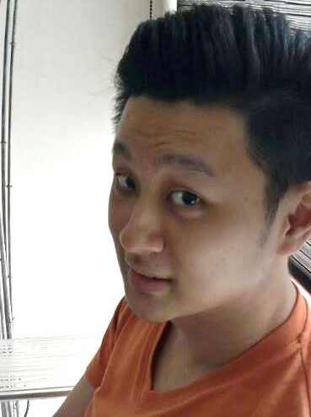
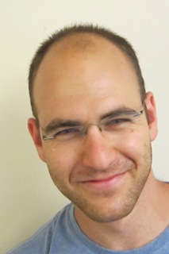

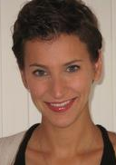
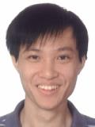
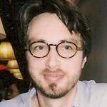
Qingyi
Zohar
Jade
Mary
Kenneth
Philippe

Slide 10
Weekly Summaries
Summary themes will be announced at the end of each Friday’s lecture, starting next week, and will also be posted on IVLE.
To receive credit, you must upload your summary to IVLE by 11:00 am the following Friday.
The maximum length for each summary is 200 words.

Slide 11
Weekly Summaries
Starting next week, a summary topic will be announced at the end of each Friday’s lecture, and will also be posted on IVLE.
You are to upload your summary to IVLE by 8 o’clock p.m. the following Thursday.
(Note that there is no summary due next week. The first summary, which I’ll announce next week, will be due on 28 August.)

Slide 12
Weekly Summaries
The date/time of your summary submission = the date/time that the IVLE system log shows that you uploaded the summary.
If you encounter technical difficulties uploading a summary to IVLE, email your summary directly to your tutor.
Late summaries will not receive credit!

Slide 13
Weekly Summaries
Summary file format: Word or plain text.
Maximum length: 200 words.
Summary filename:
<Tutorial Group> <Summary #> <Your Name>
Example: Group 5 Summary 3 Jack Chan.doc
Make sure that your name also appears at the top of your summary text. (So, your name should appear twice: once in the filename, and again in the document itself.)

Slide 14
Weekly Summaries
Summaries are marked on a curve, to ensure consistency in marking among different tutors.
The marking scheme is as follows...

Slide 15
Weekly Summaries
Most excellent summaries: 10 points
Second most excellent summaries: 8 points
Third most excellent summaries: 6 points
Least excellent summaries: 0-4 points

Slide 16
Weekly Summaries
Your tutor will mark your summary and return it to you before your next summary is due.

Slide 17
Final Exam
The final exam will be a closed book, multiple choice exam.
It will be a comprehensive exam, covering everything we discuss over the course of the term.

Slide 18
Final Exam
The final exam will be a closed book, multiple choice exam, covering everything we discuss over the course of the term.
The questions from past semesters’ exams are available via the Central Library.
Note that the content of this module changes gradually over time, so not all questions from past exams are relevant to what we’ll be covering in the module this semester.

Slide 19
Readings and notes
All required readings are available as Library E-Reserves, accessible through IVLE.

Slide 20
Readings and notes
All required readings are available in an appropriately-labeled IVLE workbin.
The readings are short, but challenging.
After every lecture, I’ll post my lecture notes and Powerpoint slides on IVLE.
(For today’s lecture only, there will be slides, but no notes.)
The lectures will also be webcast and archived on IVLE.

Slide 21
Contacting me
I welcome your feedback and inquiries!
To ensure smooth communication, I ask you to abide by two simple rules…

Slide 22
Contacting me
I welcome your thoughts and inquiries!
To ensure smooth communication, I ask you to follow two simple rules…

Slide 23
Rule #1
When you send me email, the subject line must read (in all caps):
PH1102E STUDENT INQUIRY
This is to ensure that your message does not get lost in the jungle of my inbox.
Messages with different subject lines will most likely be treated as spam.

Slide 24
Rule #2
If I do not reply to your message within three business days, please resend it with an indication that you are still waiting for a response from me.
Sometimes I let one get past me.

Slide 26
Freedom & Responsibility
background for the
philosophical debate

Slide 28
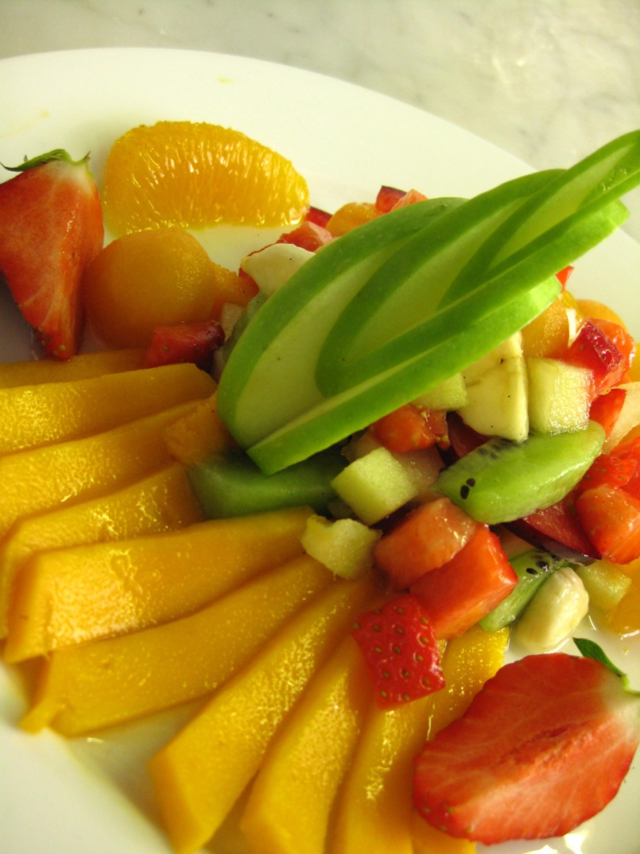
Self & Nature

Slide 29
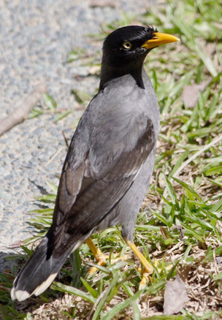
Self & Nature

Slide 30
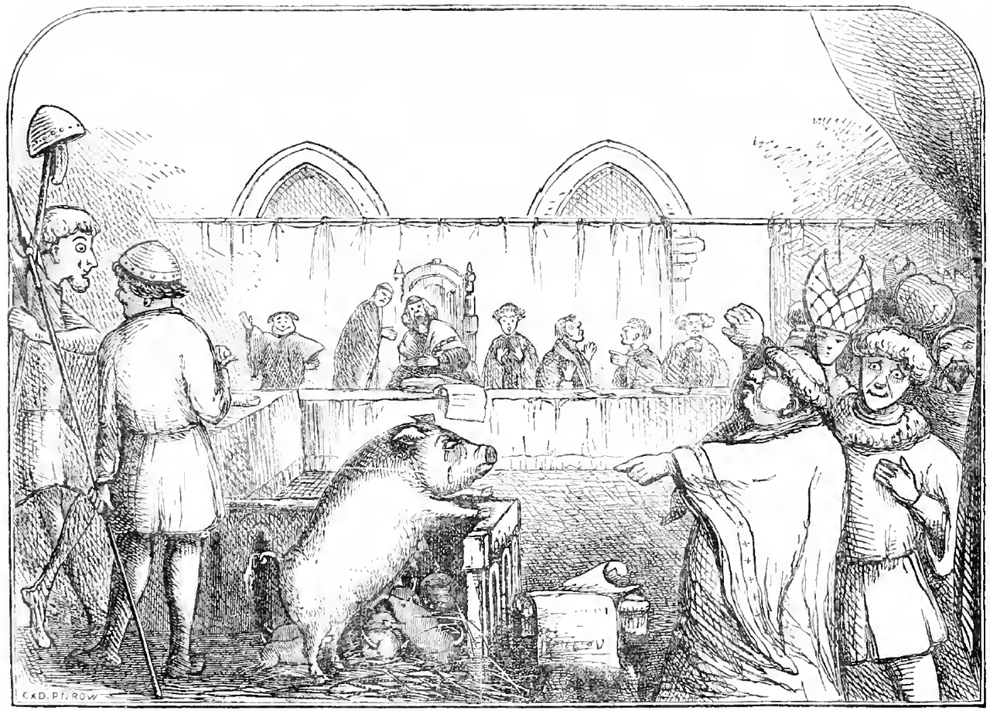

Slide 32
Self & Nature

Slide 33

Self & Nature
NTU

Slide 35
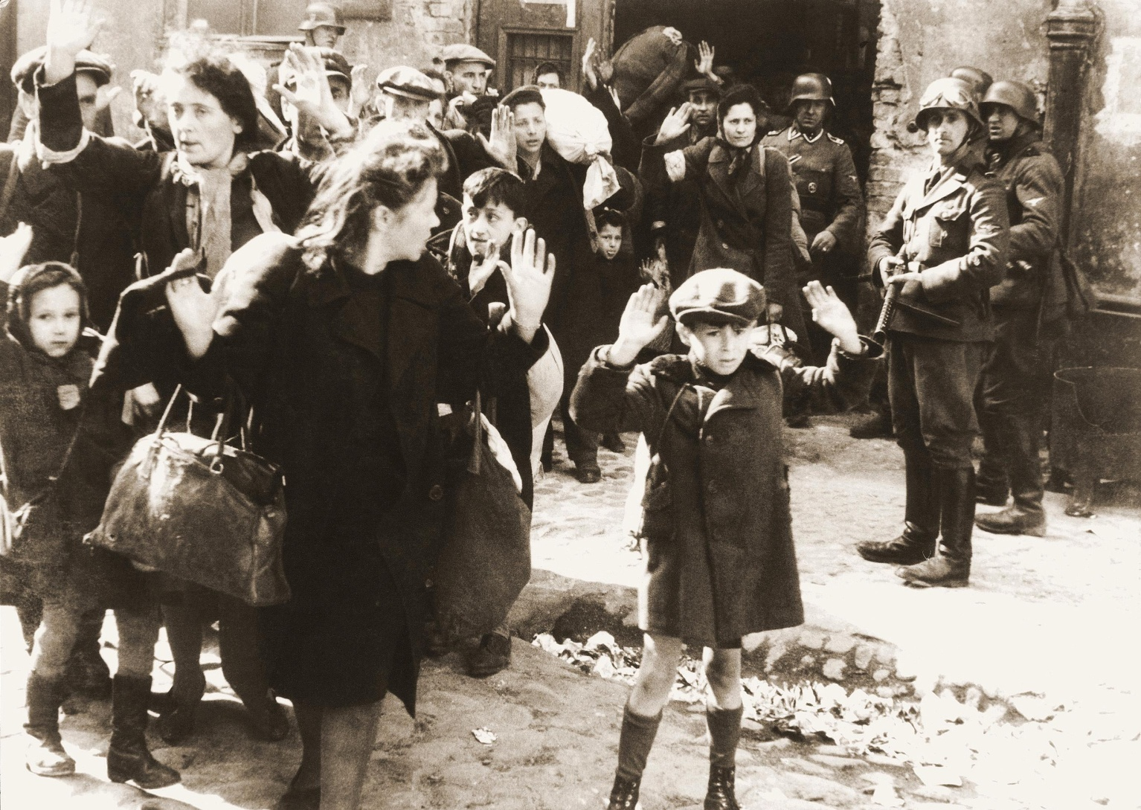

Slide 37
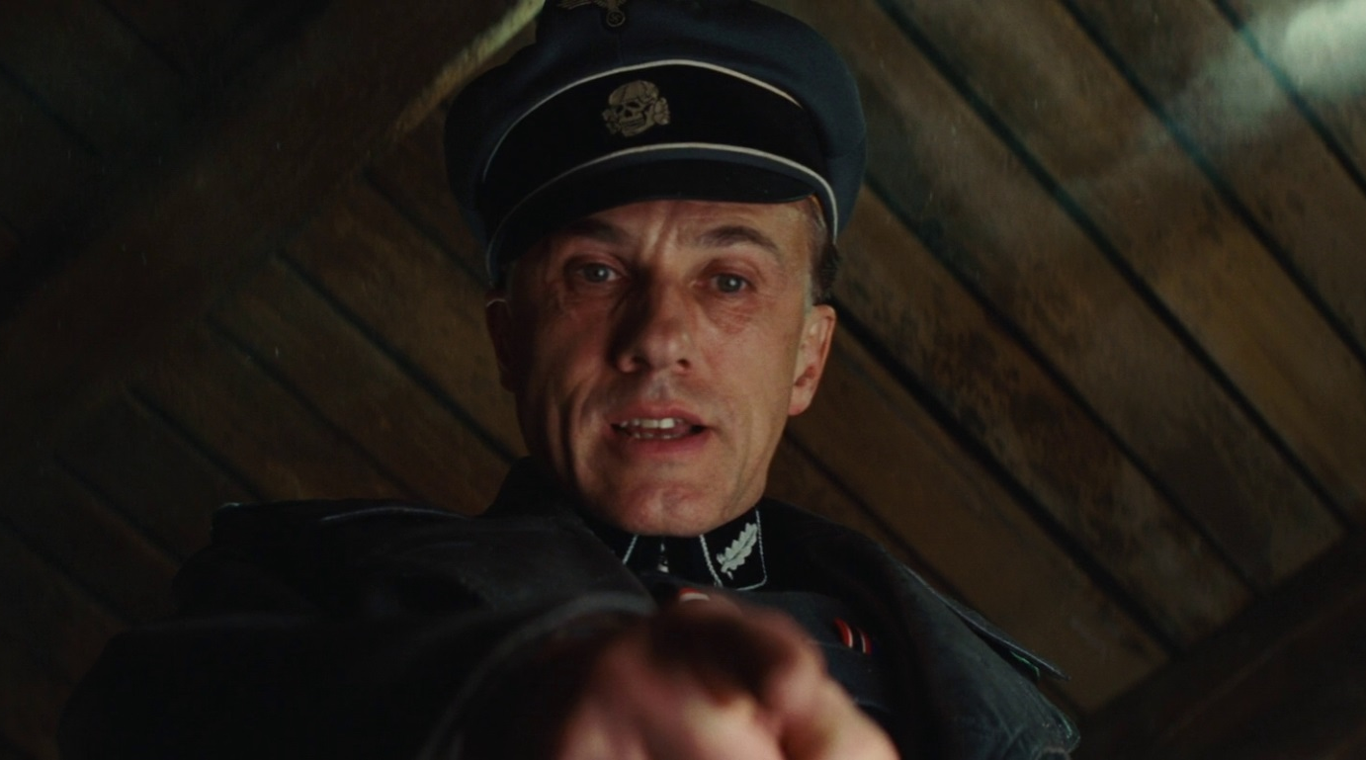

Slide 38
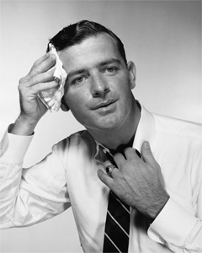

Slide 41
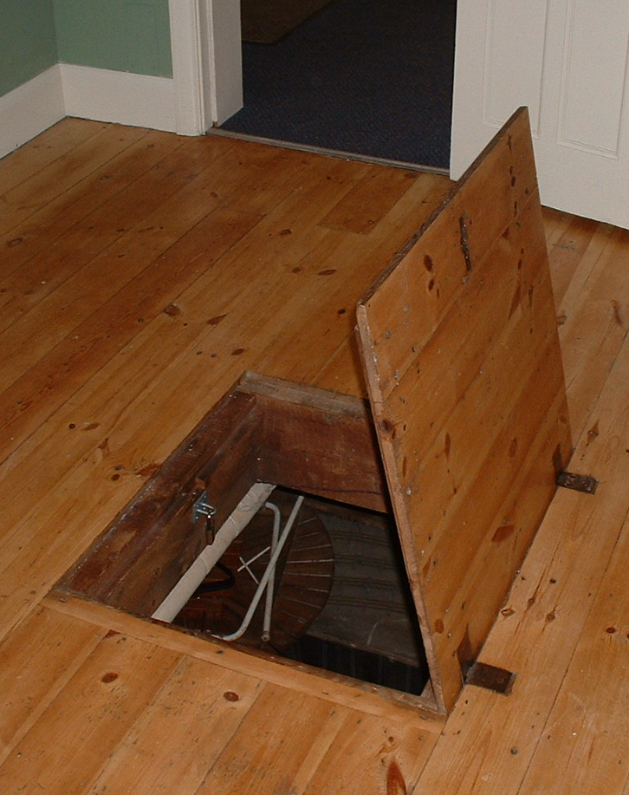

Slide 43


Slide 44
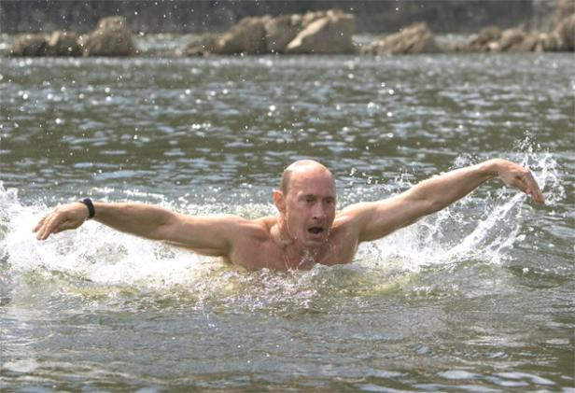

Slide 45
Moral responsibility isn’t always a bad thing!
You bear moral responsibility for something you do if you deserve to be praised or blamed for doing it.

Slide 46
Moral responsibility isn’t always a bad thing!
You bear moral responsibility for something you do if you deserve to be blamed or praised for doing it.

Slide 48


Slide 50
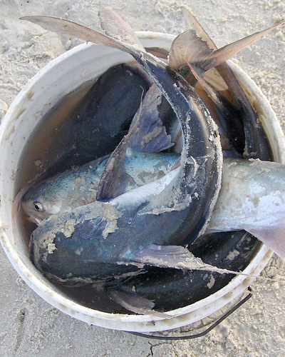

Slide 51
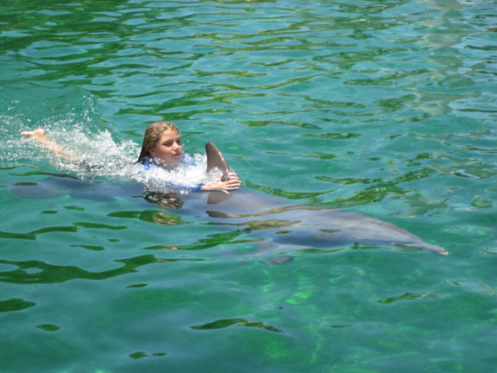

Slide 52
Responsible:
The student
Treacherous Franz
Swimmer
Fish tosser
Not Responsible:
The bird
Sweaty Franz
Ball bumper
Notes:
The bird has no control over its instincts, Franz has no control over his sweat glands, the wind has no control over the way it blows.

Slide 53
What’s the difference?
Responsible:
The student
Treacherous Franz
Swimmer
Fish tosser
Not Responsible:
The bird
Sweaty Franz
Ball bumper
Notes:
The bird has no control over its instincts, Franz has no control over his sweat glands, the wind has no control over the way it blows.

Slide 54
See you next week!

